Slide 1
PROJECT Big Data Analytics with Hadoop and R
Rajeshreddy Desham Studentid:1682826

Slide 2
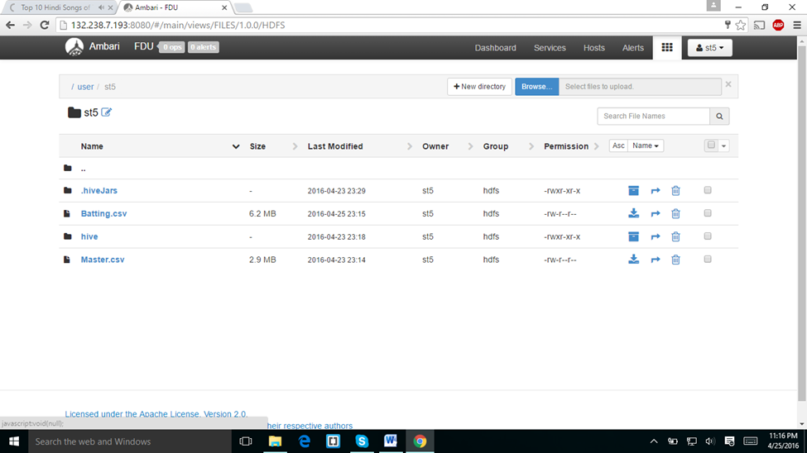
PIG
I downloaded the master.csv file from web campus and uploaded to my folder using ambari.

Slide 3
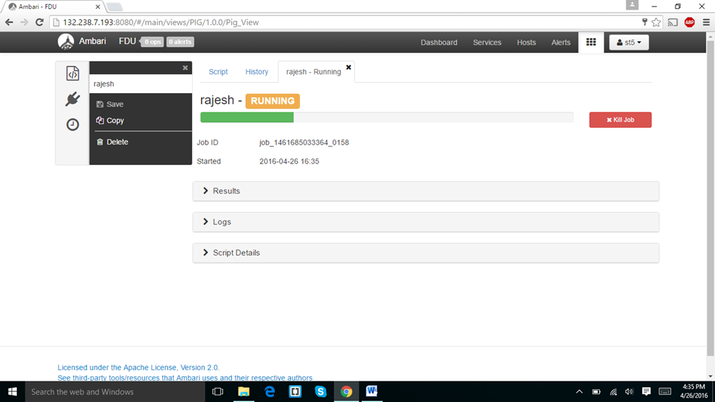
In the below screen shot I run the pig script which was given in home work document and I got the below results.

Slide 4
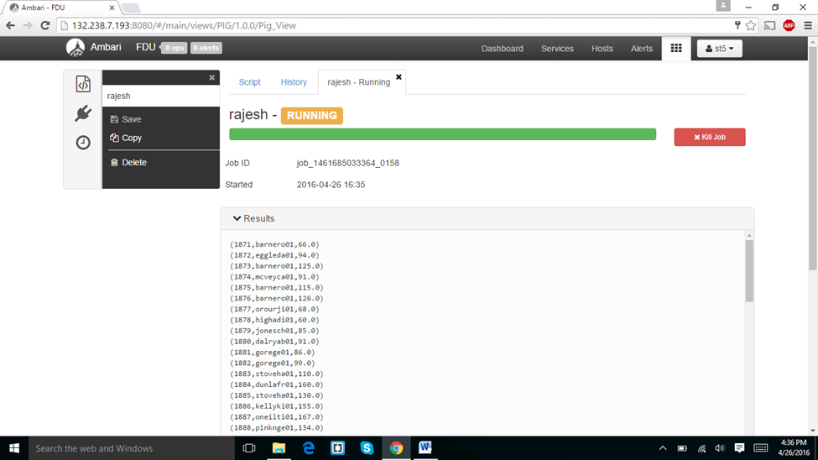

Slide 5
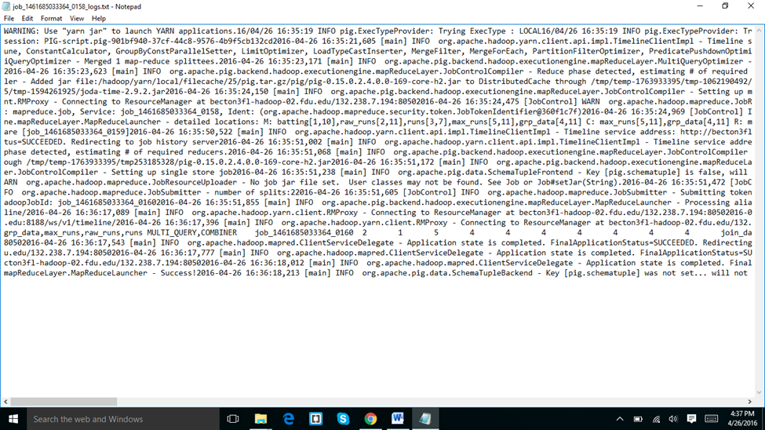
I downloaded the log files and results and the screen shots displayed below.

Slide 6
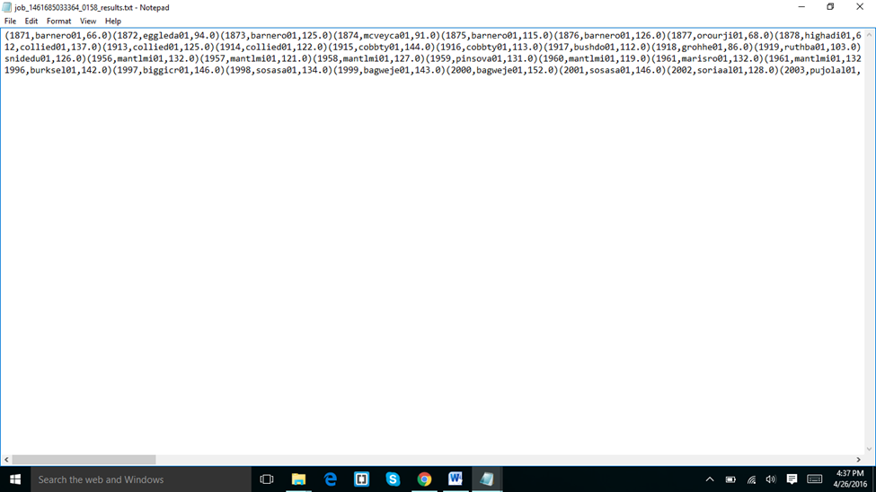

Slide 7
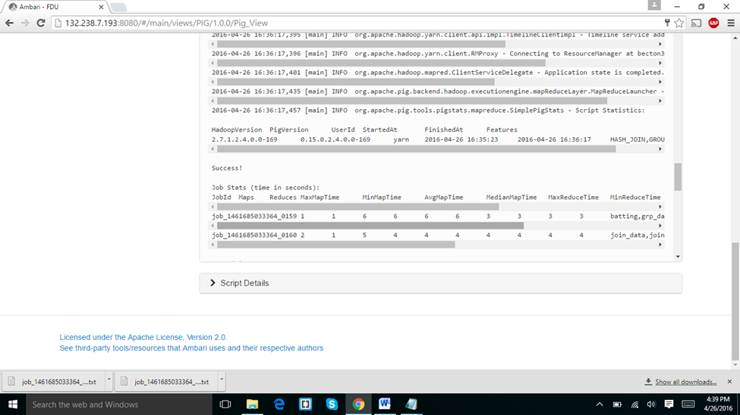
It started at 04:35:23 and end at 04:36:17. It took about 11 minutes forty seconds
I run the same script on tez but it has given some errors.

Slide 8
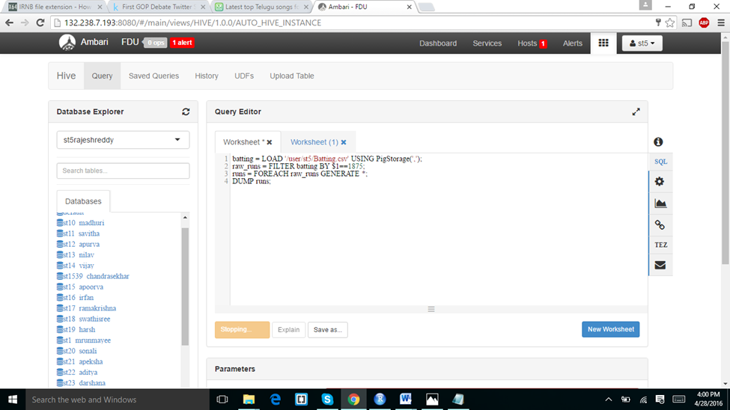

Slide 9
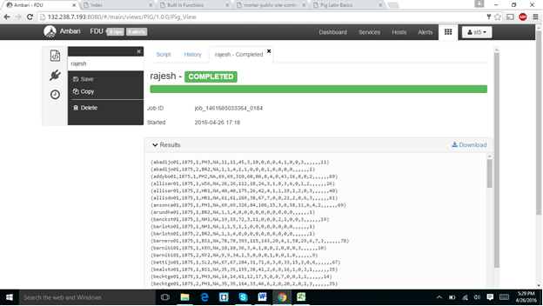
In the above screen shot I displayed the results of a particular year.

